Slide 1
Providing/Linking to Needed Supports & Services
November 4, 2021

Slide 2
Welcome & Introductions

Slide 3
Welcome
Celia Brown
OMH Regional Advocacy Specialist and Telehealth Series Spokesperson

Slide 4
Recording
Please leave your audio muted and video off (as shown with red slash marks)
Use the Chat Box if you have questions or comments during the presentation
Click More (three dots) if Chat is not visible on your screen

Slide 5
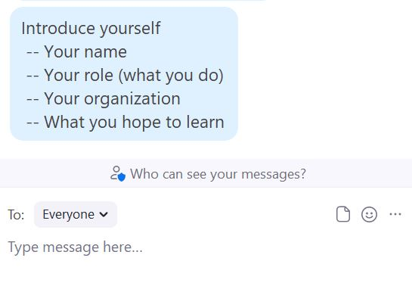
Question
Select To: Everyone, then type your introduction in the Chat Box

Slide 6
Previous Session
Telehealth Peer Support (ThPS) Communication Techniques
Communication barriers specific to telehealth
Overcoming barriers to communication through telehealth
Selecting appropriate communication techniques for successful meetings
Practicing techniques in small group role play

Slide 7
CE Credits
CE credits will be available by taking the quiz and completing the course evaluation for this and all of the sessions in the series as soon as they become available on the APS website.

Slide 8
Trainers
Carlton Whitmore, Director in Office of Consumer Affairs-
New York City Department of Health and Mental Hygiene
Lee Rivers, Executive Director at Community Connections
of Franklin County

Slide 9
Learning Objectives
The objectives of today’s session are:
Identify the 6 competencies of Providing/Linking to Needed Supports & Services category.
Explain the skills needed to match people to the most appropriate services to meet their needs.
Explain the challenges of this competency category.

Slide 10
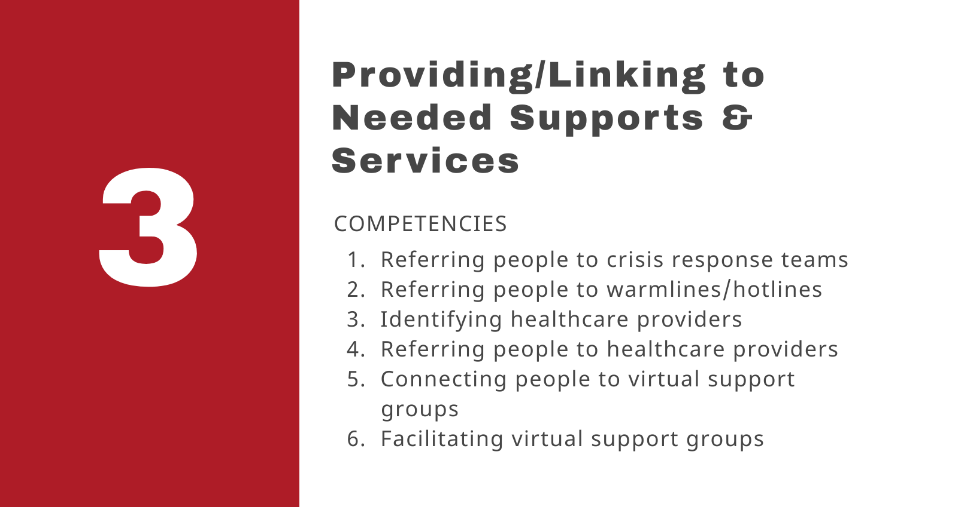

Slide 11
Question
What is your definition, perception, or understanding of ThPS?
Notes:
What definition was introduced at the beginning of the series?

Slide 12
Competency 1
Referring people to crisis response teams

Slide 13
When Referring
Obtain information
Maintain awareness of cultural /linguistic needs & resources
Use trauma-informed practices
Maintain composure
Identify most appropriate services
Notes:
Trauma informed NOT What did you do, but What happened to you
NYC Behavioral Health Crisis Services
https://www1.nyc.gov/assets/doh/downloads/pdf/mh/services-behavioral-health-crisis.pdf

Slide 14
Tips
Know resources in your county/state
Confirm referral criteria
Inform the individual of your actions & include their preferences
Response times vary
Request teams with peers
Notes:
MOBILE CRISIS TEAMS DO NOT RESPOND IMMEDIATELY
Mobile Crisis Teams use face-to-face interventions with the identified individual in crisis, as well as their family or other support systems, to engage, assess, de-escalate and connect individuals to the most appropriate services. Most MCTs include both professional and paraprofessional staff, for example, a master’s-level clinician with a peer support staff person. MCTs have common goals to: a. Assist individuals experiencing a crisis event to resolve the crisis situation when possible. b. Provide intervention in an environment where the individual experiencing the crisis is most comfortable and the intervention is least restrictive (often their home or other place in the community); c. Provide appropriate care/support while avoiding unnecessary law enforcement involvement, emergency department use, and hospitalization when possible; d. Link individuals in crisis to all necessary medical and behavioral health services that can help resolve the situation and prevent future crises.

Slide 15
Competency 2
Referring people to warmlines/hotlines

Slide 16
Tips
Know resources
Prioritize peer-run warmlines/hotlines
Verify resources on a regular basis
Notes:
No need to reinvent the will
Most warmlines can connect you to a crisis hotlines
https://power2u.org/peer-run-warmlines-resources/
https://power2u.org/wp-content/uploads/2018/03/Warmline-Guide.pdf

Slide 17
Comparison
Hotlines
Crisis and/or suicide
Screening & assessment
Active rescue policies
May not work in pre/post crisis
Warmlines
Voicemail/call back
No screening or assessment
May refer to other services
Typically work in pre/post crisis

Slide 18
Competency 3
Identifying healthcare providers

Slide 19
Tips
Use internet search
Confirm services, address, contact info
Ask about referral
Verify how services are delivered
Prioritize culturally competent services
Notes:
Peer should identify and confirm services are still being offered, by first calling the provider before referring the individuals.
Peer should be diligent about the source of information they are utilizing about services in their community.
Utilizing google search to find services in your area.
Calling the service provider to verify their address, hours of services and that they are offering all the services listed.
Verifying how the services are delivered, and how to refer individuals.

Slide 20
Examples
Calling providers to ask about service delivery & referral process
12-Step groups offered 24-hour services online around the world
Notes:
During the onset of COVID-19 I had to call a mental health provider to determine how their counseling sessions were being delivered and how they were accepting referrals since their office was closed.
During the onset of COVID, 12 steps groups expanded accessibility of online supports. They were able to make groups accessible 24 hours a day in many countries around the world.

Slide 21
Question
How have you used this competency in your work?

Slide 22
Competency 4
Referring people to healthcare providers

Slide 23
Tips
Focus on known providers
Verify contact information
Follow-up
Assist with making contact
Notes:
S

Slide 24
Competency 5
Connecting people to virtual support groups

Slide 25
Tips
Search internet & word-of-mouth
Go to 12-step websites
Verify the platform, assist with tech
Test software
Start your own
Notes:
Search internet for virtual support groups. Many groups emerged during the pandemic and are not always easy to find. Word of mouth is one of the mst reliable ways to identify these groups
Go to 12-step websites , which usually provide current listings
Verify the platform used and assist downloading any software needed to participate in meeting
Test software prior to meeting
If you don’t find a support group tht meets your needs, consider starting your own!

Slide 26
Competency 6
Facilitating virtual support groups

Slide 27
Tips
Familiarize yourself
Step-by-step instructions
Develop structure/agenda
Co-facilitate
Be careful of posting meeting links
Privacy settings
Create a safe space
Use webcams
Get feedback
Notes:
Zoom
• GoTo Meeting or GoTo Training
• Google Hangouts
• Skype
• Microsoft Teams
• Slack
• Adobe Connect
• Facebook Live, if you have a private
Facebook group
_________________________________________________________________________________
NA Virtual groups during COVID
__________________________________________________________________________________
Also see, HOW TO START A VIRTUAL SUPPORT GROUP.
HOW TO RECRUIT NEW MEMBERS
___________________________________________________________________________________
https://iocdf.org/wp-content/uploads/2014/09/Support-Group-Planning-Sheet1.pdf
________________________________________________________________________________________
https://www.mhanational.org/sites/default/files/MHA%20Support%20Group%20Facilitation%20Guide%202016.pdf

Slide 28
Question
How have you used this competency in your work?

Slide 29
Challenges
Technology challenges to overcome for success

Slide 30
Challenges
Variety of Technologies
Call-only cell phones
Smart phones
Computers
Limited data
Notes:
Individuals utilize different technology to communicate today. Some utilize a cell phone that only makes calls and others utilize a smart phone, or a computer that can connect them directly to the internet. Some phones have limited data capacity that will not allow them to stay connected for the entire service time.
Insert brief description of Topic 1
The challenges that people face with technology and data to linking and accessing telehealth peer services.

Slide 31
Examples
During COVID-19 Pandemic
Recipents lacked virtual meeting experience
Staff needed training
Staff then trained recipients
Notes:
During the COVID-19 outbreak individuals across the world who were, use to attending groups in person, all the sudden needed to learn how to attend groups virtually or meet with a provider virtually. A lot of these individuals did not have experience on how to attend a virtual group or meet with their providers virtually.
We as providers had to teach our staff the process of how to properly utilize virtual platforms to deliver services.
After being trained our staff had to teach participants how to utilize virtual platforms for services.

Slide 32
Acquiring Skills
Peer Support Specialists Need:
Access to resources and technology to acquire skills
Community resources
Technology training
Notes:
Peers should have access to resources and technology from their employer in order to gain skills needed.
Employer should provide community resource to staff.
Employer should provide training on technology utilized at the agency.

Slide 33
Example
Untrained PSS needing to train participants
Notes:
Challenges were faced when a Peer was asked to provide assistance to program participants who had no knowledge or technical training which is essential when utilizing virtual services.

Slide 34
Small Group Activity

Slide 35
Small Group Instructions
10 minutes: Role play linking someone to a warmline, healthcare provider, or support group.
Peer Support Specialist
Service Participant
10 minutes: Discuss role play
What went well?
What could have been improved upon
What are the challenges of linking someone to these supports/services?

Slide 36
Large Group Processing

Slide 37
Question
What did you discover in this practice activity?

Slide 38
Question
How can you apply this topic in your work?

Slide 39
Wrap Up

Slide 40
Today We Talked About
1
Strategies for meeting the 6 competencies in this category
2
Demonstrating providing/linking people to needed supports & services
3
Challenges related to this category

Slide 41
Maryam’s Minute
As the Academy of Peer Services End User Support Specialist, Maryam has combined her training and experience as a NYAPRS Peer Bridger with her excellence in customer service to provide a unique form of ThPS.

Slide 42
Next Training
The topic of the next ThPS training session is
Documentation & Technology
November 18, 2021

Slide 43
Question
What is the most important thing you’re taking away from this session?

Slide 44
Thanks
Any questions?

Slide 45
Credits
Slideshow design by Athena Rayne Anderson, PhD, MEd
Robot body parts available free online.

